Slide 1
WISDM-51 Demo 2
Group: Joao Lucas Veras and Sania Bandekar
Team Number: 6
Notes:
Sania-
Welcome to our presentation on WISDM-51 Demo2
We are Team 6, my name is Joao Lucas Veras and Sania Bandekar
Today we'll walk you through our data visualization and preprocessing efforts

Slide 2
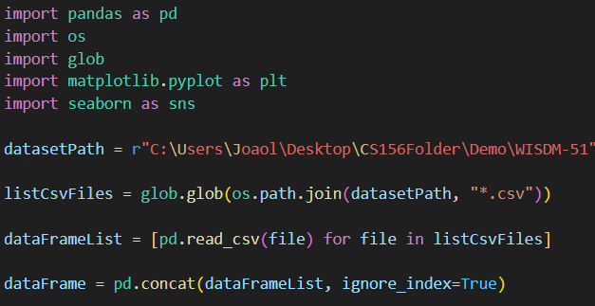
Dataset Imports
Library Utilized
Pandas
OS/Glob
Matplot
Seaborn
Notes:
Sania-
For this project, we utilized several key libraries:
Pandas: for data manipulation and analysis
OS/Glob: for file handling and pattern matching
Matplotlib: for creating static, animated, and interactive visualizations
Seaborn: for statistical data visualization

Slide 3
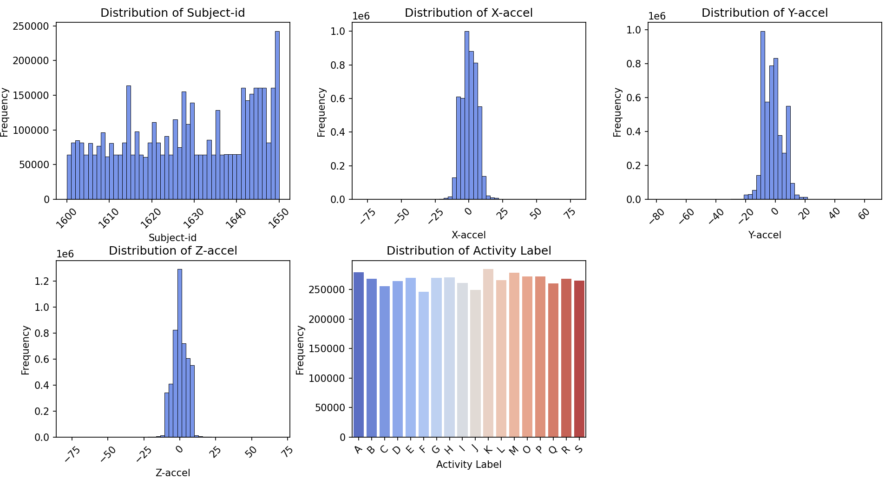
Data Visualization - Histogram
Notes:
Joao-

Slide 4
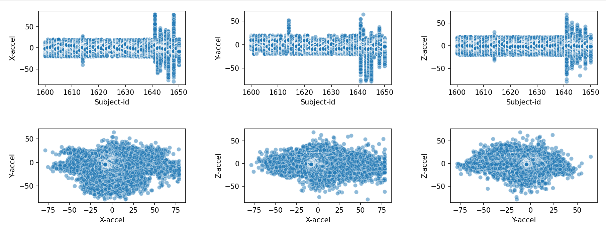
Data Visualization - Scatter Plots

Slide 5
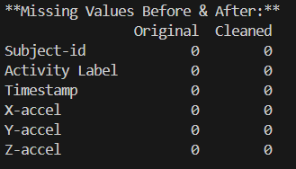
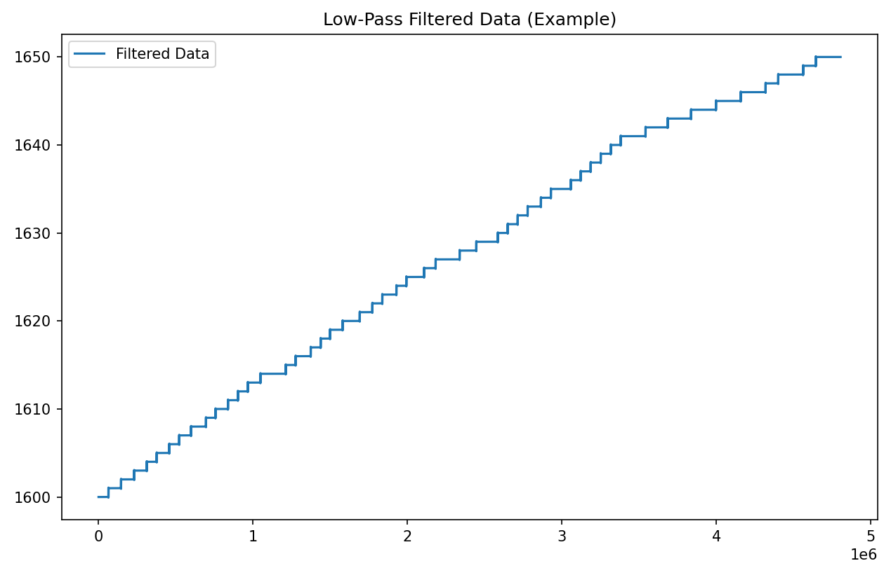
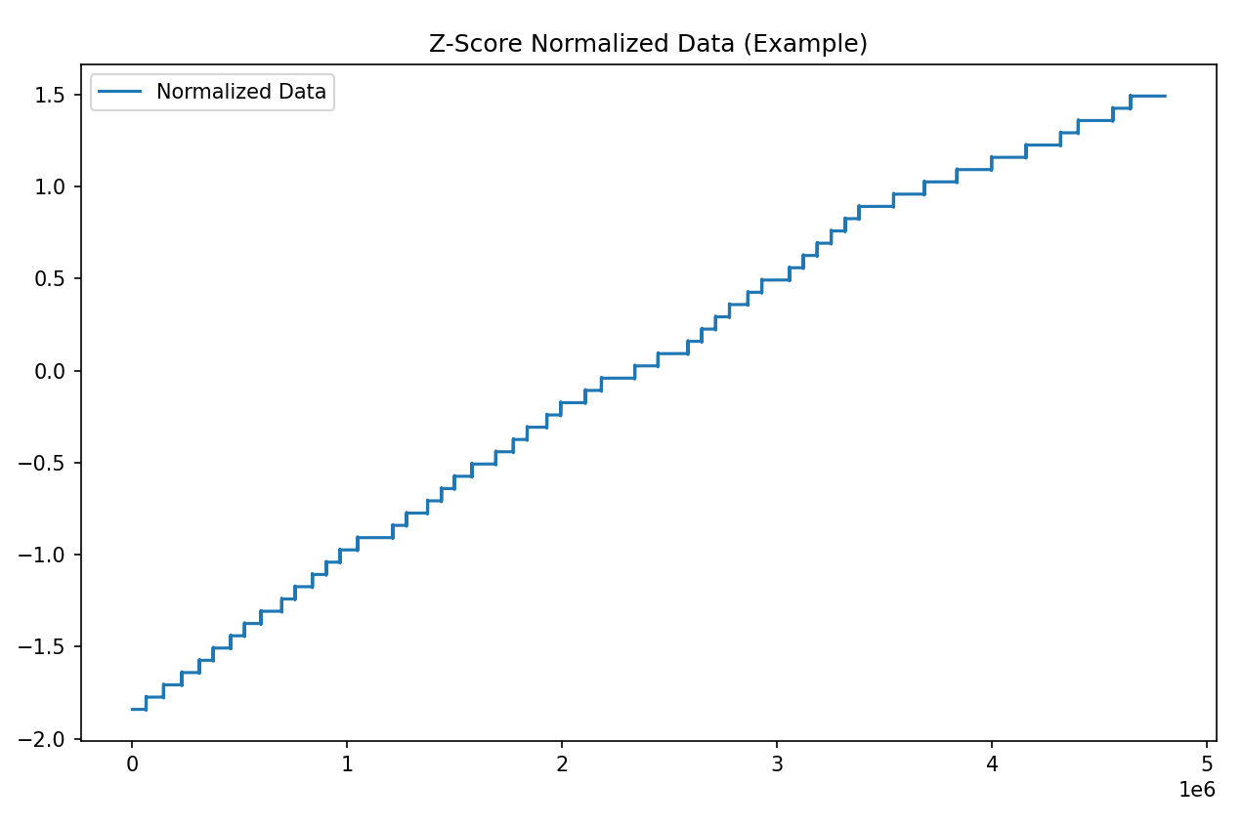
Data Preprocessing
We utilized mean imputation, interpolation, and mode to fill in missing values and saved into a cleaned .csv file
After comparing we found no missing values
Notes:
Sania-
In our preprocessing phase, we addressed missing values using three methods:
Mean imputation
Interpolation
Mode imputation
Segmenting the data into fixed-size windows.
We saved the cleaned data into a new CSV file
After our preprocessing efforts, we're pleased to report that we found no remaining missing values in our dataset

